Slide 1
Significant Change Training
for Researchers
Kristina Adams, Lynn Anderson, Doreen Bartlett, John Dennis,
& JR Haywood

Slide 2
Goals
Improve the research environment for the PI by defining the significant change process
Foster understanding of regulatory requirements
Increase efficiency of significant change approval process

Slide 3
Learning Objectives
By the end of this session, participants will be able to:
Explain the difference between significant and other changes
Outline processes for making protocol changes
Provide constructive suggestions to the IACUC in consideration of significant changes
Assess how the protocol can be written to enable flexibility and avoid the need for future modifications

Slide 4
Significant and Other Changes
“In brief, significant changes include changes that have, or have the potential to have, a negative impact on animal welfare. In addition, some activities that may not have a direct impact on animal welfare are also considered to be significant.” - OLAW Guidance on Significant Changes to Animal Activities (NOT-OD-14-126)
http://grants.nih.gov/grants/guide/notice-files/NOT-OD-14-126.html

Slide 5
Significant and Other Changes
Think-Pair-Share Identify examples of significant changes.

Slide 6
Processes for Making Significant and Other Changes
Full Committee Review (FCR) and Designated Member Review (DMR) are IACUC approval methods described in the PHS Policy. Veterinary Verification and Consultation (VVC) is verification by a veterinarian that the significant change is in compliance with IACUC reviewed and approved policies and appropriate for the animals in the circumstance. An increase in previously approved animal numbers may be handled administratively according to an existing, approved IACUC policy.

Slide 7
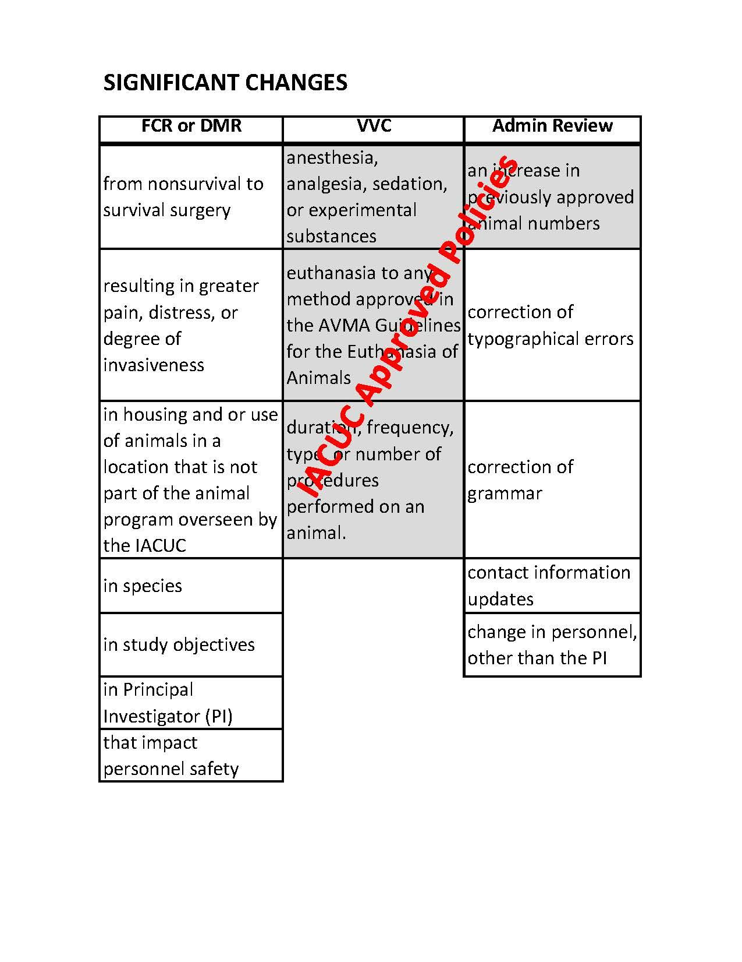

Slide 8
Processes for Making Significant and Other Changes: Matching Now that you’ve seen examples of changes that may be made, work together to match the examples in your packet to the correct method/process that should be used: Examples may include: Switching from terminal procedure and whole liver collection to survival surgery involving liver biopsies.
FCR/DMR | VVC | Administrative Review

Slide 9
Constructive Input
“The IACUC has some discretion to use IACUC-reviewed and -approved policies to define what it considers a significant change, or to establish a mechanism for determining significance on a case-by-case basis in accordance with the PHS Policy IV.C.1.a-g. It is the IACUC’s responsibility to clearly define and communicate its policy for determining significance to investigators.” - OLAW Guidance on Significant Changes to Animal Activities (NOT-OD-14-126)
http://grants.nih.gov/grants/guide/notice-files/NOT-OD-14-126.html

Slide 10
Constructive Input
- The IACUC is not limited to the examples provided in the OLAW guidance. - The IACUC may develop policies that are in the best interest of the institution. They may solicit input from the research community. - The IACUC should establish the scope of the procedures that can be managed by the VVC process.

Slide 11
Constructive Input: Brainstorm
Name some examples of significant changes that could be handled by VVC that are not specifically included in the OLAW guidance.
Each table will develop a list of examples.
Present to the class.
Group and rank examples based on information from each group.
Assign one procedure per group for discussion based on questions below. - What are the limits of the procedures (if any)? - What is the scope of the policy? - What is the justification for needing the policy?
Report out for each procedure.

Slide 12
Flexible Protocol Writing
The Guide lists 15 components of an animal study proposal that the IACUC needs to consider in approving an animal activity (see handout). Some of these could be written in such a way to enhance flexibility and minimize the need for future modifications. For example, nonstandard housing and husbandry requirements:
“Depending upon the results of some described studies, mice may be isolated in metabolic cages to collect urine samples for 2-4 days and will then be returned to social housing.”

Slide 13
Flexible Protocol Writing: Brainstorm
Select 3 components that could be written to enhance flexibility and provide specific examples for each.

Slide 14
Lessons Learned
Explain the difference between significant and other changes
Outline processes for making protocol changes
Provide constructive suggestions to the IACUC in consideration of significant changes
Assess how the protocol can be written to enable flexibility and avoid the need for future modifications

